Slide 1

Bright Coffee Sales Insights Presentation
BY ONALENNA MOGALE

Slide 2


Agenda
Total Revenue per Product Type
Peak Time Intervals for Sales
Quantity of Items Sold by Product Category
Best-Selling Products (Type & Details)
Key Takeaways

Slide 3
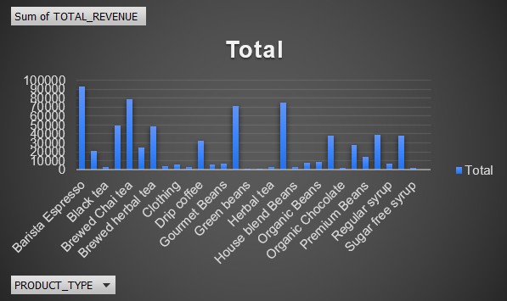
Total Revenue per Product Type
Objective: Understand which product types generate the most revenue.
Insight: Certain product types (e.g., barista espresso, brewed coffee) are top revenue drivers.
Actionable Point: Focus marketing and upselling strategies on these high-revenue products.

Slide 4
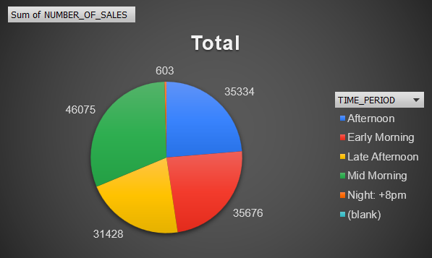
Peak Time Intervals for Sales
Objective: Identify the busiest times of the day for sales.
Insight: Mid-morning and afternoon show the highest sales activity.
Actionable Point: Increase staffing and promotions during peak periods to maximize sales.

Slide 5
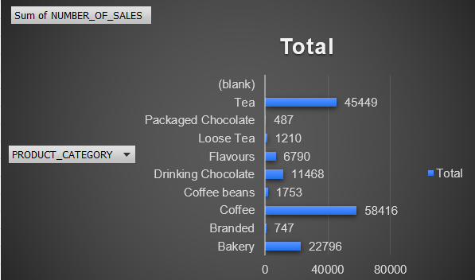
Quantity of Items Sold by Product Category
Objective: Measure product demand by category.
Insight: Coffee consistently outperforms other categories, followed by tea and chai.
Actionable Point: Ensure consistent stock levels for high-demand categories.

Slide 6
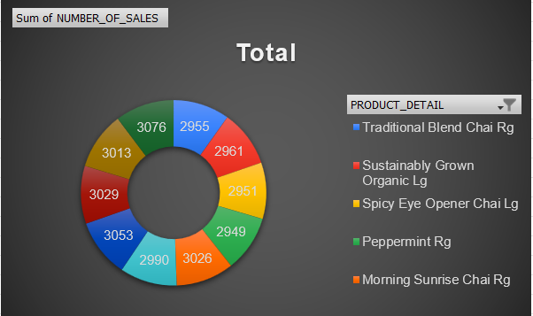
Best-Selling Products (Details)
Objective: Highlight the top individual products.
Insight: Products like Latte and Ethiopia coffee rank among the top sellers.
Actionable Point: Promote these products further, create bundles, or feature them as seasonal specials.

Slide 7

Key Takeaways
Focus on high-revenue product types for strategic growth.
Leverage peak time intervals with targeted promotions and staffing.
Monitor stock levels for top categories to avoid shortages.
Spotlight best-selling products in marketing campaigns.

Slide 8
Closing
Thank You! Questions & Discussion

